Slide 1
EN 410 Energy Management
Gurubalan Annadurai
guru.a@iitb.ac.in

Slide 2
Compressor modulation
Proper selection of a right combination of compressors and optimal modulation of different compressors can conserve energy.
If all compressors are similar, the pressure setting can be adjusted such that only one compressor handles the load variation, whereas the others operate more or less at full load.
If compressors are of different sizes, the pressure switch should be set such that only the smallest compressor is allowed to modulate (vary in flow rate).
If different types of compressors are operated together, unload power consumptions are significant. The compressor with lowest no load power must be modulated.

Slide 3
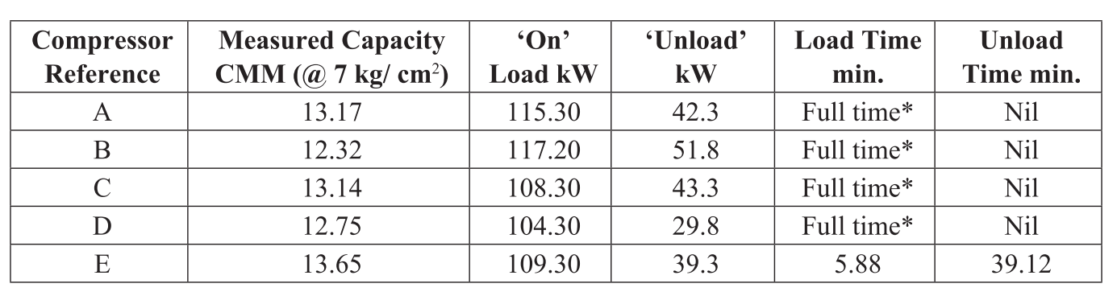
Compressor modulation
Following observation is noted for reciprocating compressors.
How much capacity is utilized?
Comment on the operation

Slide 4
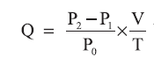
Compressor air assessment – Pump up method
Free air delivery
Should not deviate more than 10% as per design value
Empty the receiver, close all the connections after receiver, and note down the time taken to reach the set pressure.
m³/min

Slide 5
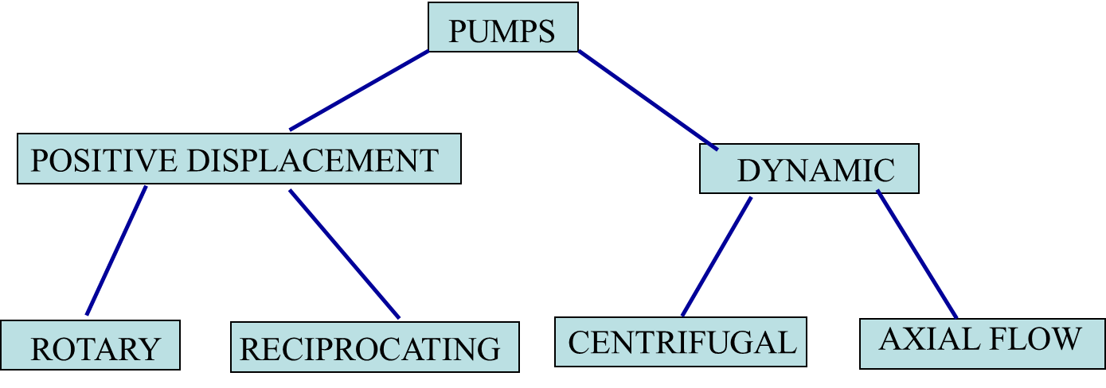
Pumps
U.S. industrial sector - pumping systems account for 25% of the total energy consumed by electric motors and over 50 % of the electricity in pumping intensive industries
Pump reliability is important—often critically so.
In cooling systems, pump failure can result in equipment overheating and catastrophic damage.
In lubrication systems, inadequate pump performance can destroy equipment.
In many petrochemical and power plants, pump downtime can cause a substantial loss in productivity.

Slide 6
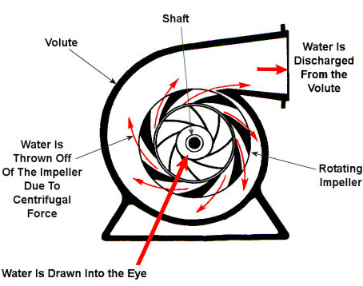
Centrifugal pumps
Centrifugal pumps are more common –simple, safe to operate, require minimal maintenance, and have characteristically long operating lives.
Centrifugal pumps typically suffer less wear and require fewer part replacements than positive displacement pumps.
Packing or mechanical seals must be replaced periodically, these tasks usually require only a minor amount of downtime.

Slide 7
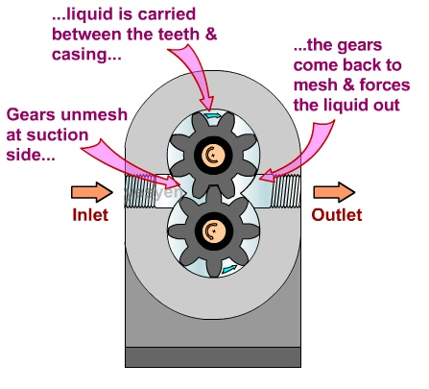
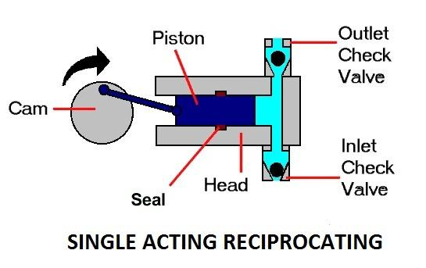
Positive displacement pumps
The system requires high-pressure, low-flow pump performance
The pump must be self-priming
The working fluid must not experience high shear forces
The flow must be metered or precisely controlled
Disadvantage – Deadheading

Slide 8
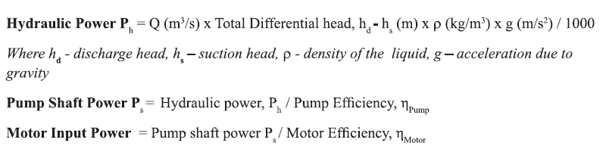
Pump performance parameters
Pump flow, Q = 0.40 m³/ s
Electrical Power supplied, P = 325 kW
Suction head (Tower basin level), h1 = +1 m
Delivery head, h2 = 55 m
Motor efficiency = 88%
Density of water = 996 kg/m³
Net Head
Hydraulic power
Pump shaft power
Pump efficiency

Slide 9
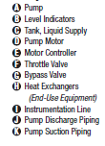
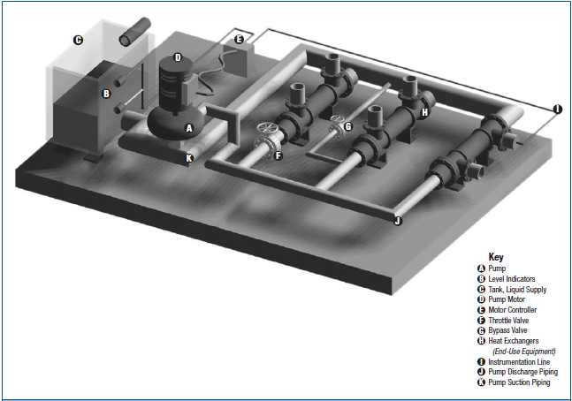
Pumping system

Slide 10
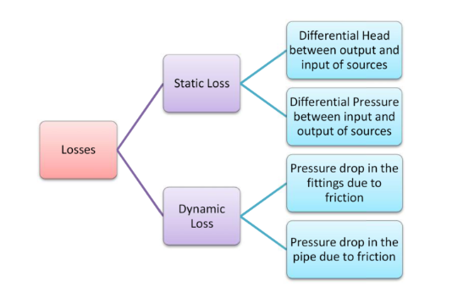
Pumping system losses

Slide 11
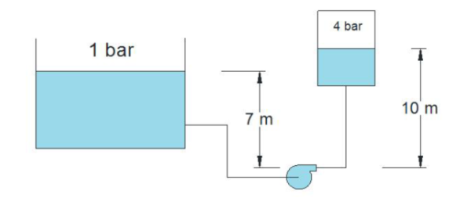
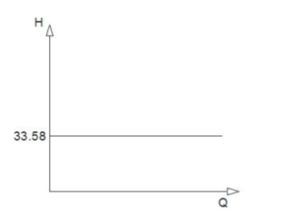
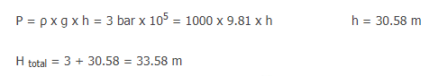
Static loss

Slide 12
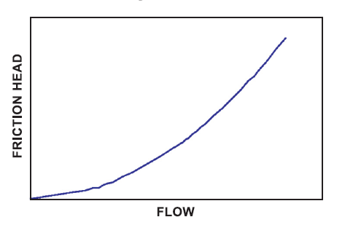
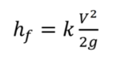
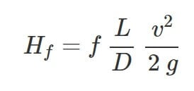
Dynamic losses
Valves fittings, entry, exit
Due to pipe friction

Slide 13
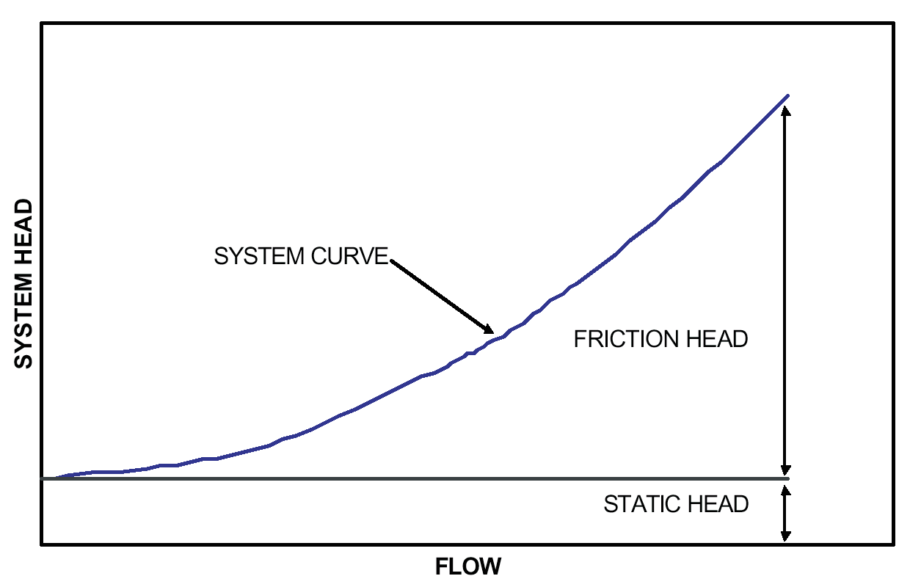
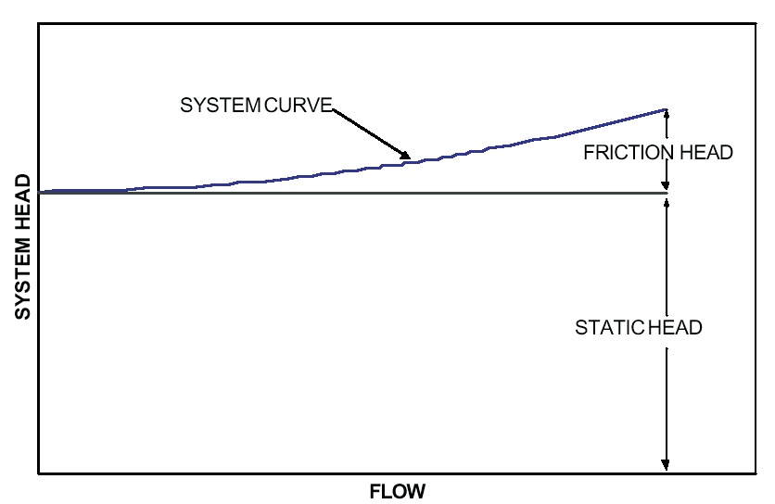
System curve

Slide 14
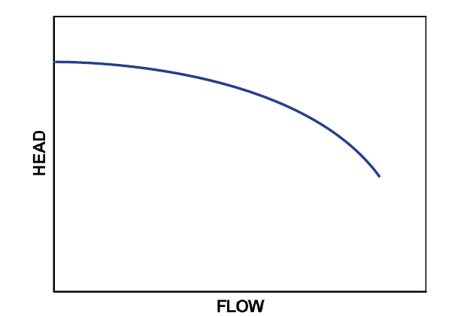
Pump curve
Decreasing (but flat) due to eddy and shock losses
Further decreasing (become parabolic) due to frictional losses

Slide 15
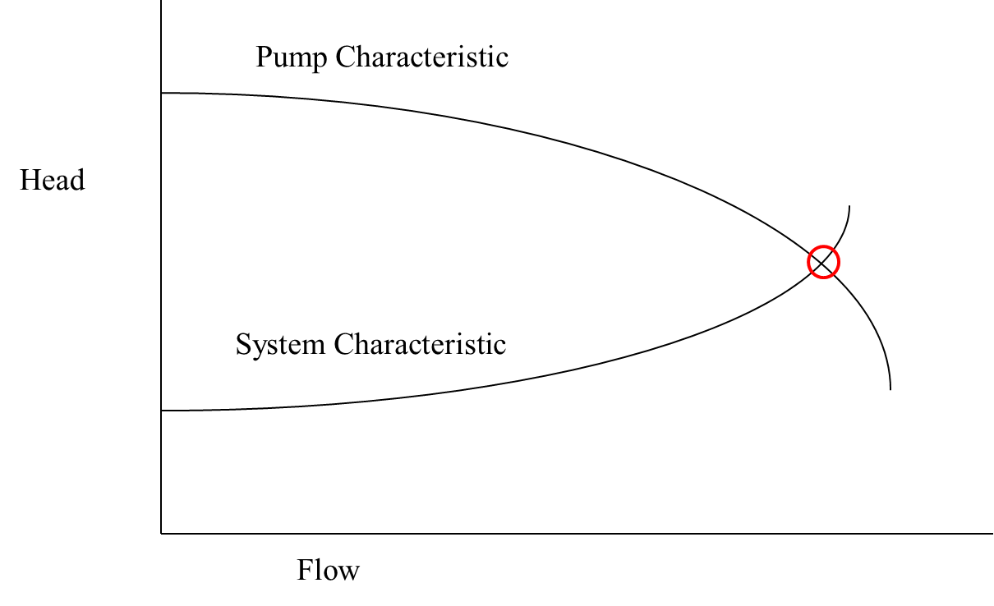
Operating point

Slide 16
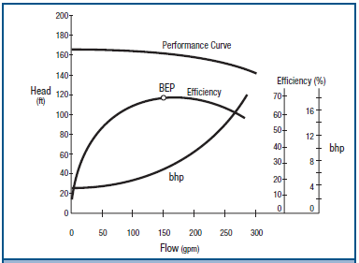
Best efficiency point (BEP)

Slide 17
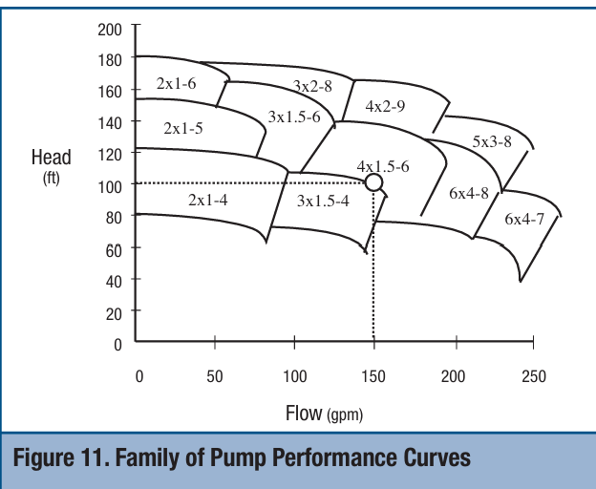
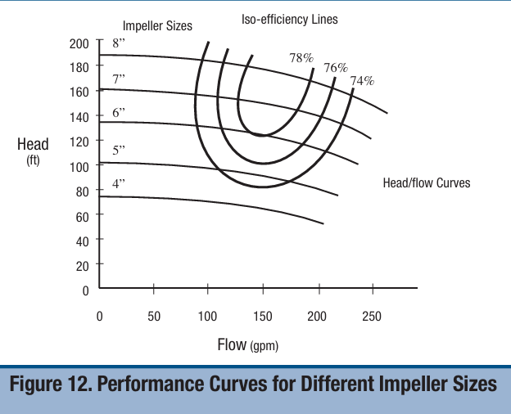
Pump selection curve

Slide 18
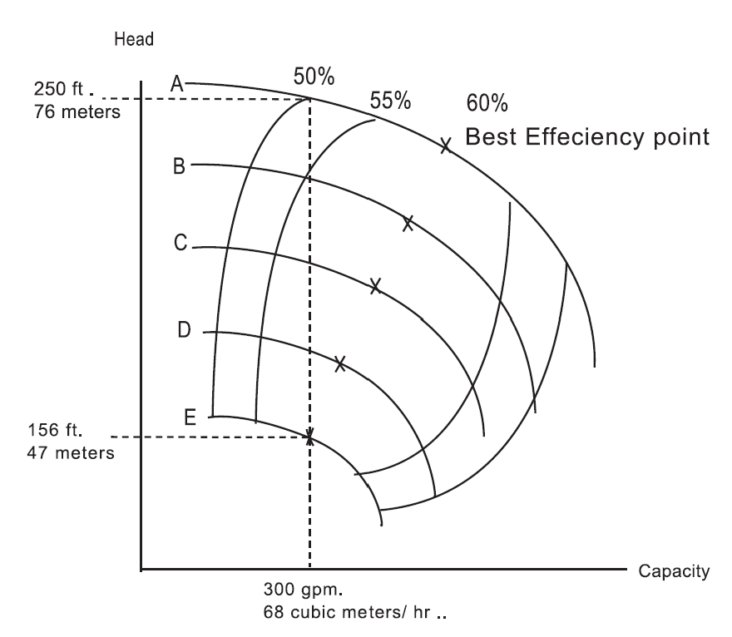
Effect of oversized pump
What happened if we select A instead of E?
Pump cost of E is INR 300000
Operating hours = 8000 hrs./year
Utility rate = INR 5.5/kWh
Motor efficiency = 90%
Density of water = 1000 kg/m³

Slide 19
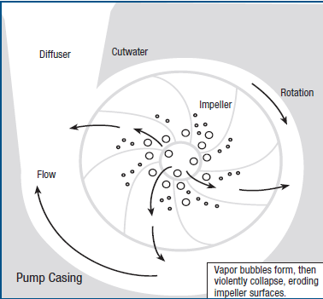
Cavitation
Crackling and popping noises that often sound like marbles passing through the pump
For applications in which cavitation is to some extent unavoidable, high-tensile-strength materials should be specified for the impeller

Slide 20
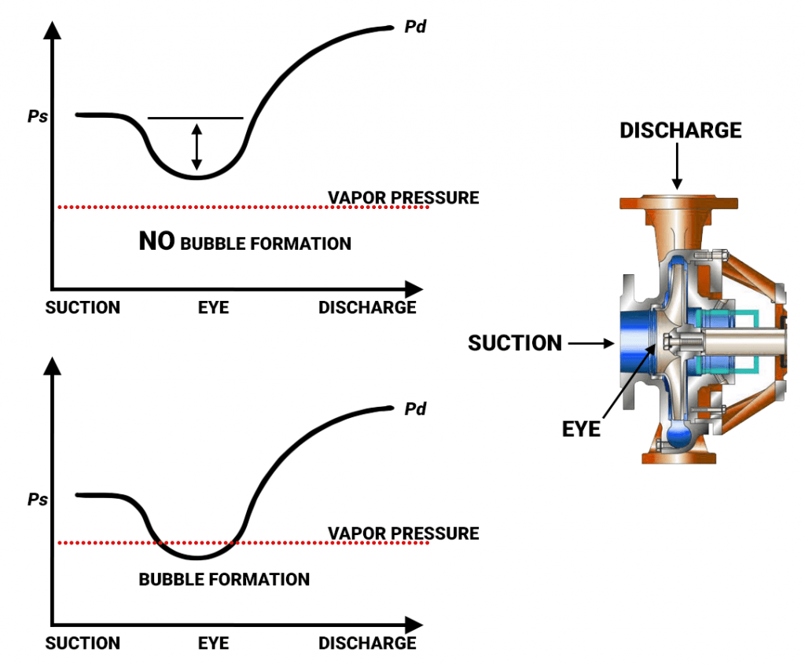
Net positive suction head

Slide 21
Pump Control Strategies
Often Oversizing – Does not operate at Design point
Bypass Control
Throttling
Variable Speed Drives
Trimming Impeller (reducing Diameter)

Slide 22
Bypass control
Pump runs continuously at the maximum process demand level, with a permanent bypass line attached to the outlet.
When a lower flow is required, the surplus liquid is bypassed and returned to the supply source.

Slide 23
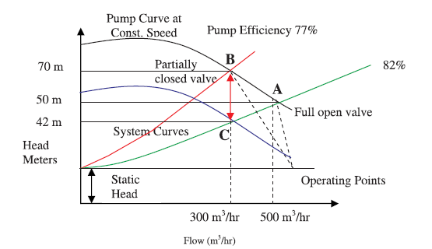
Valve control method

Slide 24
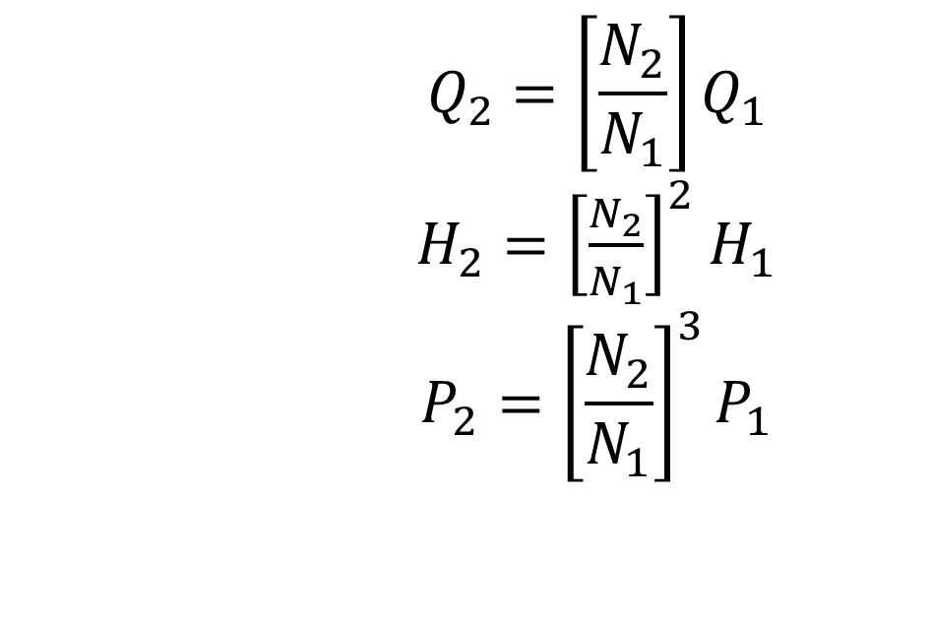
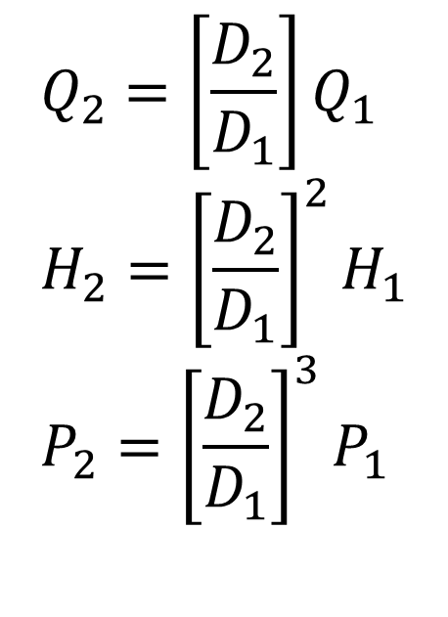
The Affinity Laws
$$Q_{2}=\left[\frac{D_{2}}{D_{1}}\right]Q_{1} \\ H_{2}={\left[\frac{D_{2}}{D_{1}}\right]}^{2}H_{1} \\ P_{2}={\left[\frac{D_{2}}{D_{1}}\right]}^{3}P_{1}$$
$$Q_{2}=\left[\frac{N_{2}}{N_{1}}\right]Q_{1}$$ $H_{2}={\left[\frac{N_{2}}{N_{1}}\right]}^{2}$ $H_{1}$ $$P_{2}={\left[\frac{N_{2}}{N_{1}}\right]}^{3}P_{1}$$

Slide 25
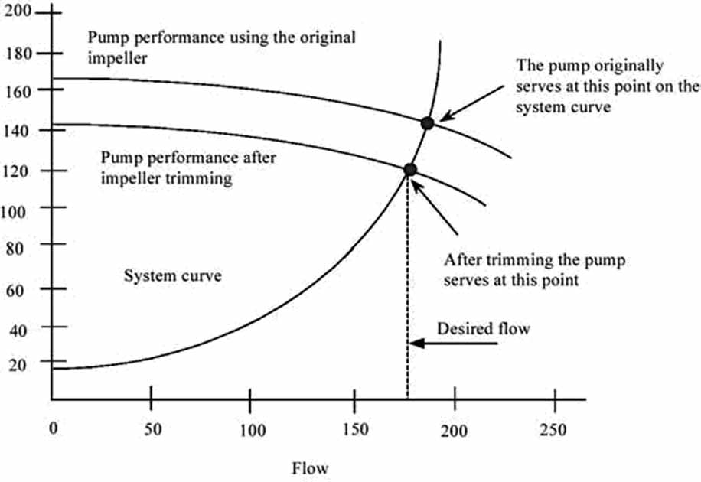
Impeller trimming to reduce flow
Permanent changes
Impeller diameters are rarely reduced below 70% of their original size

Slide 26
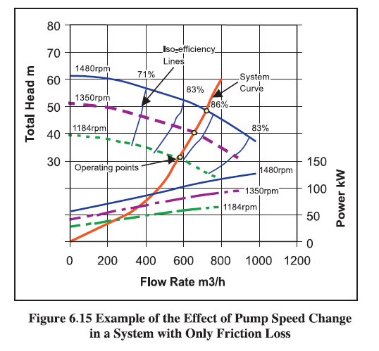
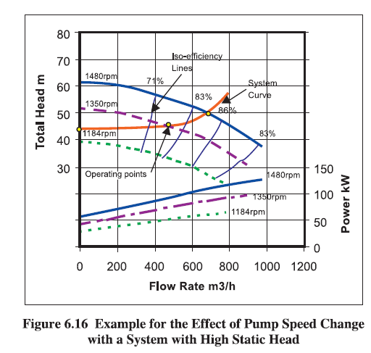
Speed Control

Slide 27
Pump speed adjustments
Multiple-speed pump motors and variable speed drives (VSDs)
Multiple-speed motors: different set of windings for each motor speed
Expensive, less efficient, discrete speeds
Mechanical VSDs: hydraulic clutches, fluid couplings, and adjustable belts and pulleys.
Electrical VSDs: eddy current clutches, wound-rotor motor controllers, and variable frequency drives (VFDs)

Slide 28
Speed control
A centrifugal pump, pumping water operates at 35 m³/h and at 1440 RPM. The pump operating efficiency is 68% and motor efficiency is 90%. The discharge pressure gauge shows 4.4 kg/cm². The suction is 2 m below the pump centerline. If the speed of the pump is reduced by 50% estimate the new flow, head and power.
Original Modified
flow:
head:
power:

Slide 29
Speed control
A centrifugal pump, pumping water operates at 35 m³/h and at 1440 RPM. The pump operating efficiency is 68% and motor efficiency is 90%. The discharge pressure gauge shows 4.4 kg/cm². The suction is 2 m below the pump centerline. If the speed of the pump is reduced by 50% estimate the new flow, head and power.
Original Modified
flow: 35 m³/h 17.5 m³/h
head: 46m 11.5 m
power: 7.17kW 0.9kW

Slide 30
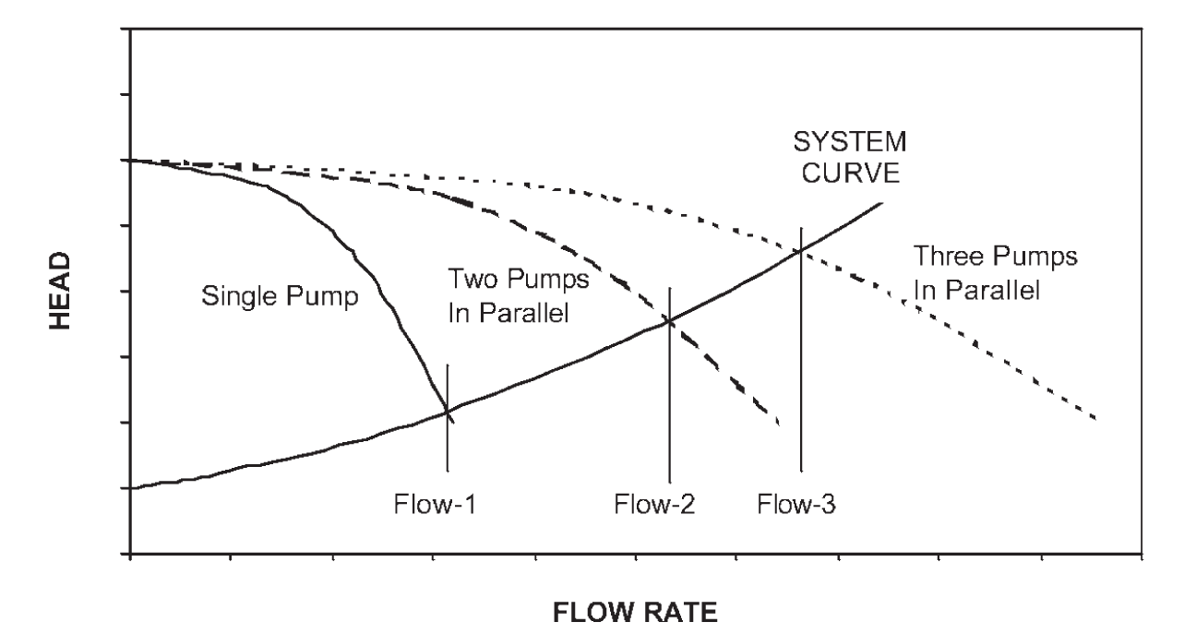
Pumps in Parallel

Slide 31
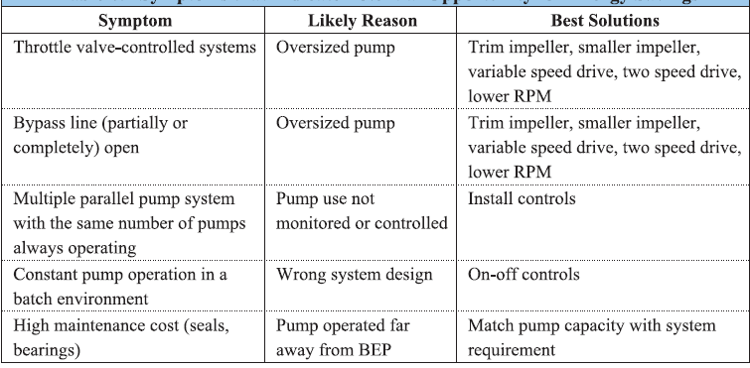
Symptoms for energy efficient operation

Slide 32
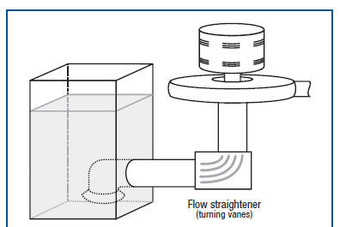
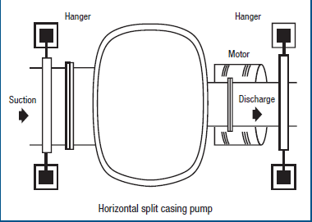
Piping arrangements

Slide 33
References
https://www.energy.gov/sites/prod/files/G_Overview_of_Pump_Systems_Matter.pdf
https://blog.craneengineering.net/pumps-dont-suck-and-other-centrifugal-pump-basics
https://marinersgalaxy.com/what-is-reciprocating-pump-and-how-i/
https://pumpsdesign.com/system-characteristic-curve/
https://www.springerpumps.com/productnews/npsh-net-positive-suction-head-matters/
https://www.energy.gov/sites/prod/files/2014/05/f16/pump.pdf

